Slide 1
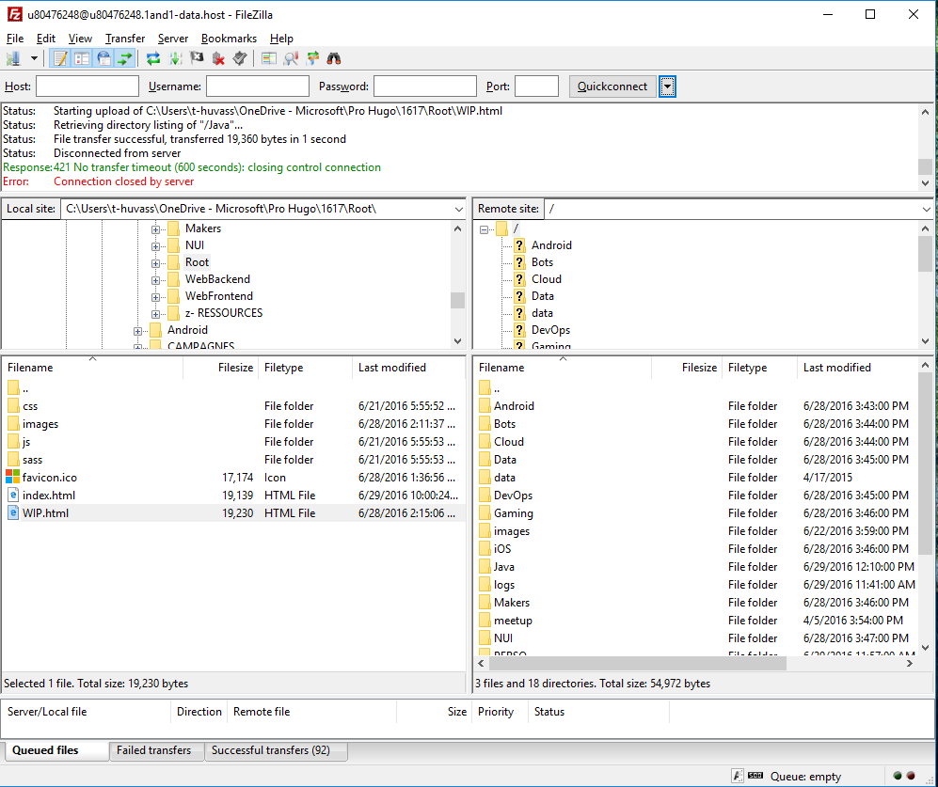
LOCAL
SERVEUR
UPLOAD
DOWNLOAD

